Slide 1

ADSP 32021 IP01 MACHINE LEARNING OPERATIONS Data-Driven Models for Accurate Car Valuations

Slide 2




TEAM 3
Yash Bhardwaj
Nia
Gangar
Arushi Makraria
Praveen N Mohankumar
Senior ML Engineer
Senior Data Scientist
Data
Scientist
Data
Scientist
Model Training & Evaluation
AutoML & Model Monitoring Test
Feature Engineering & Pipeline Design
EDA & Deployment

Slide 3


BUSINESS PROBLEM
PROBLEM STATEMENT
How can we accurately predict the resale price of a used car based on its features such as manufacturing year, present market price, kilometers driven, and ownership history?
GOAL
Build a machine learning pipeline to predict the Selling Price of used cars, using AutoML to refine the category of algorithms and optimize model performance. Deploy the model with monitoring to ensure reliability and evaluate the impact of feature modifications on predictions.
Notes:
Let’s dive into the core of our project, starting with the business problem we aim to address.
The resale price of a used car is influenced by various factors like its manufacturing year, the present market price, kilometers driven, and ownership history. The challenge here is: How can we accurately predict the resale price of a used car based on these features? This prediction can provide immense value to both buyers and sellers by ensuring transparency and reliability in the used car market
"Our goal is to build a robust machine learning pipeline that predicts the selling price of used cars. To achieve this, we will leverage AutoML to experiment with various algorithms and optimize the model’s performance. Beyond just prediction, we aim to ensure reliability by deploying the model with monitoring mechanisms and continuously evaluating the impact of feature modifications on predictions.”
Let’s now explore how the data supports this goal.

Slide 4
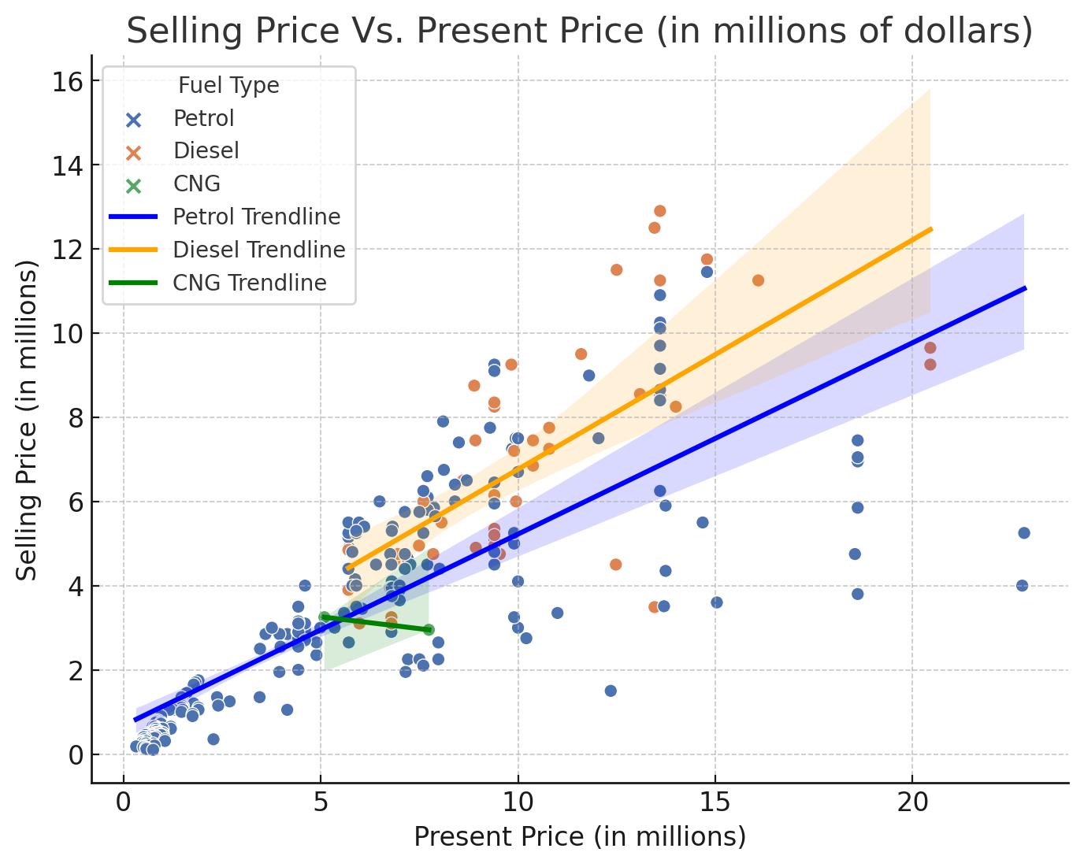
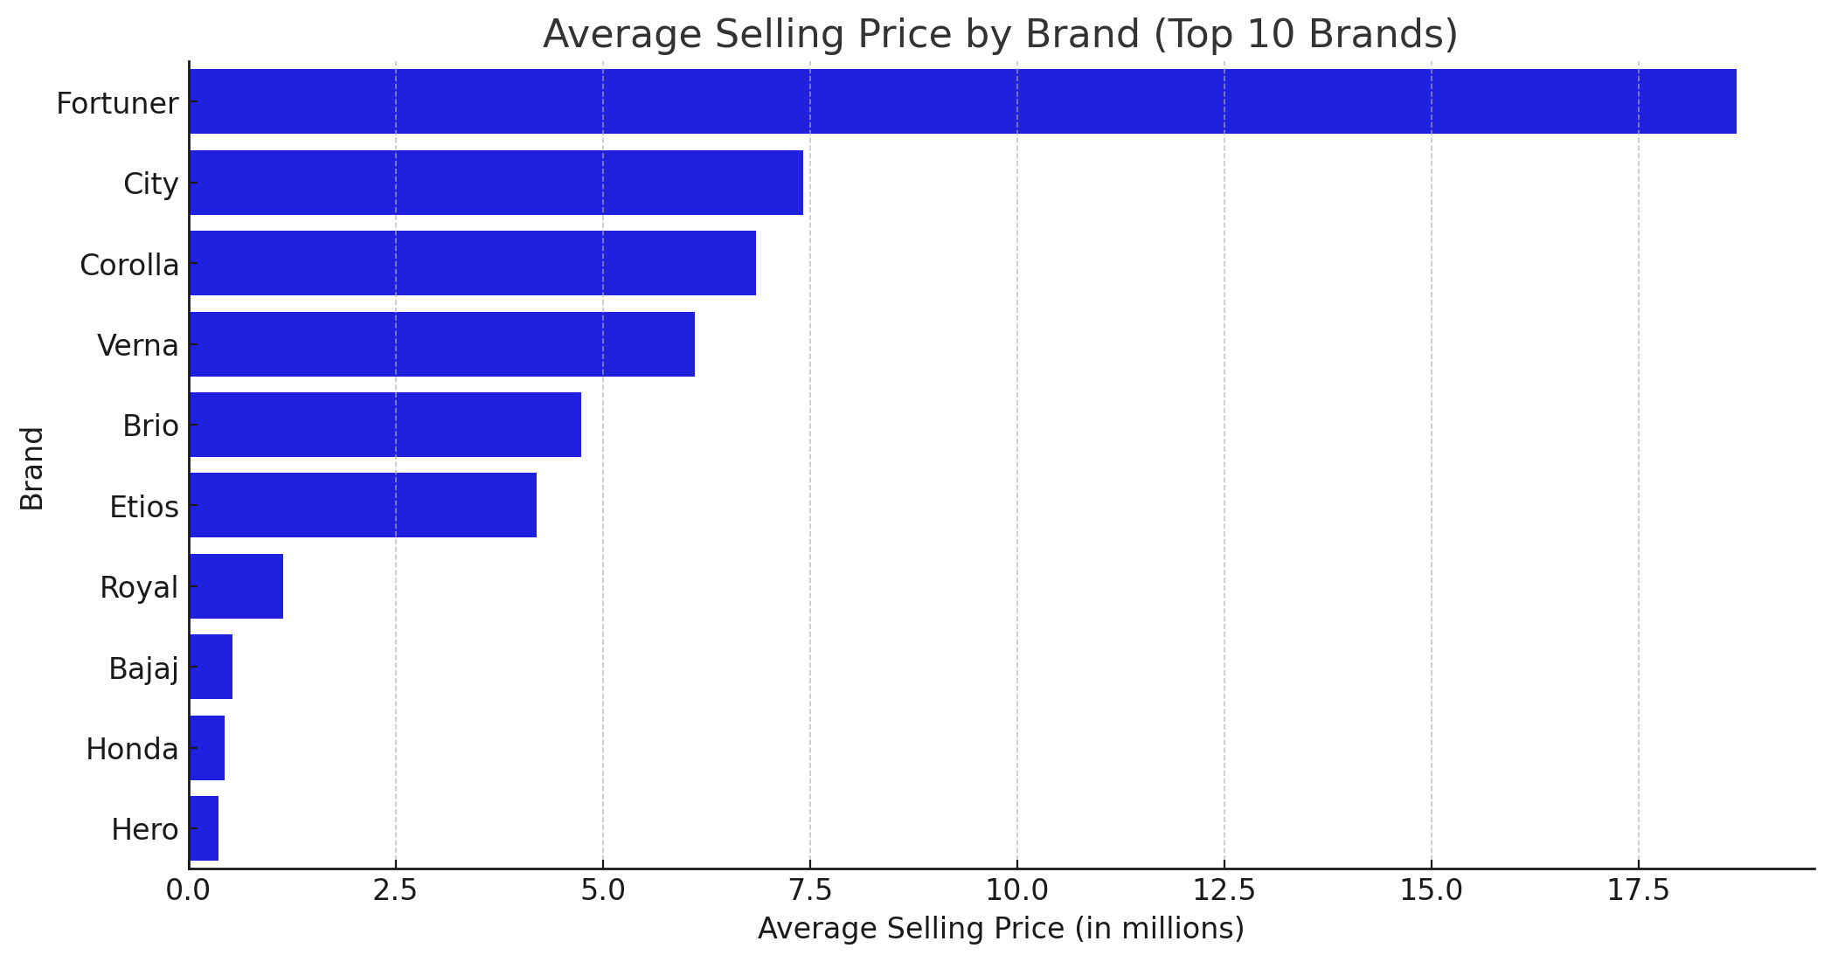
DATA OVERVIEW – EDA 1
1
Diesel vehicles have higher resale value trends compared to Petrol and CNG, as reflected in the trendline
2
Fortuner leads in average selling price among the top 10 brands, followed by City and Corolla
3
A positive correlation exists between Present Price and Selling Price across all fuel types
Notes:
First, Diesel vehicles stand out for their higher resale value trends compared to Petrol and CNG cars, as clearly reflected in the steeper Diesel trendline on the scatter plot. This suggests that Diesel cars tend to hold their value better over time.”
Next, when we analyze brand-level performance, Fortuner takes the lead with the highest average selling price among the top 10 brands, followed by City and Corolla. This indicates strong brand value and demand for these models in the used car market
Lastly, a consistent positive correlation exists between Present Price and Selling Price across all fuel types, confirming that higher Present Prices generally translate into higher Selling Prices

Slide 5
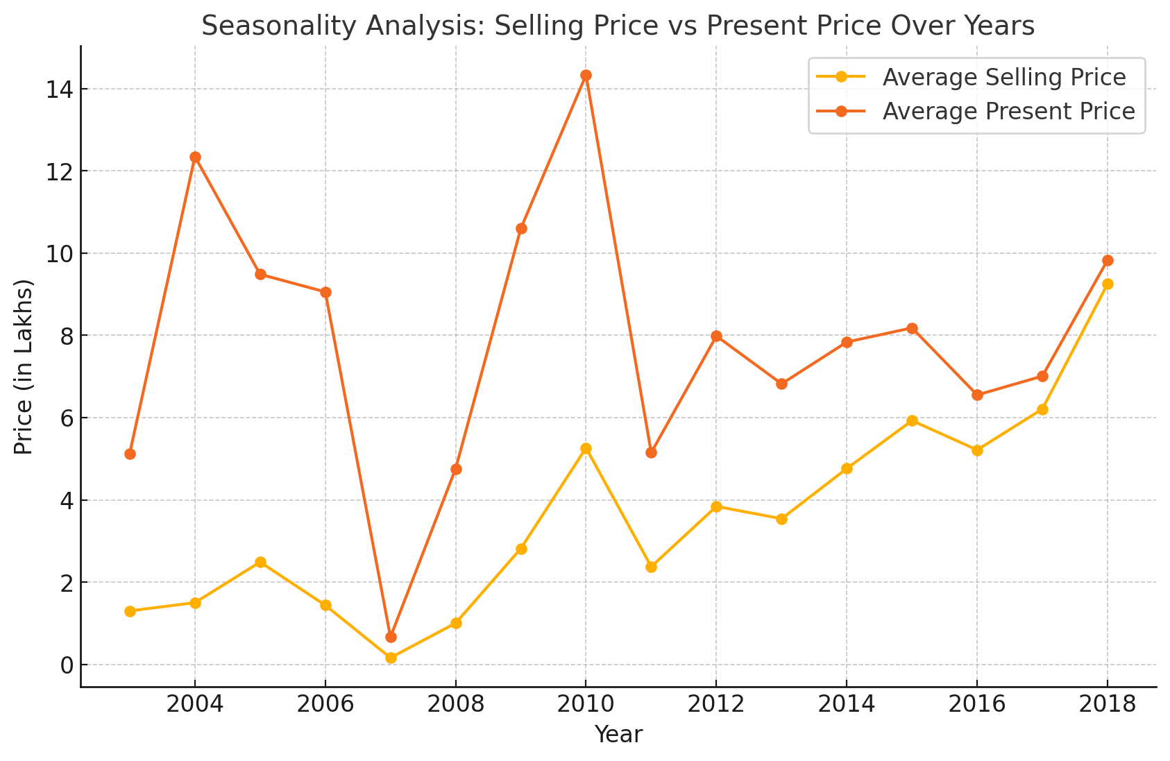
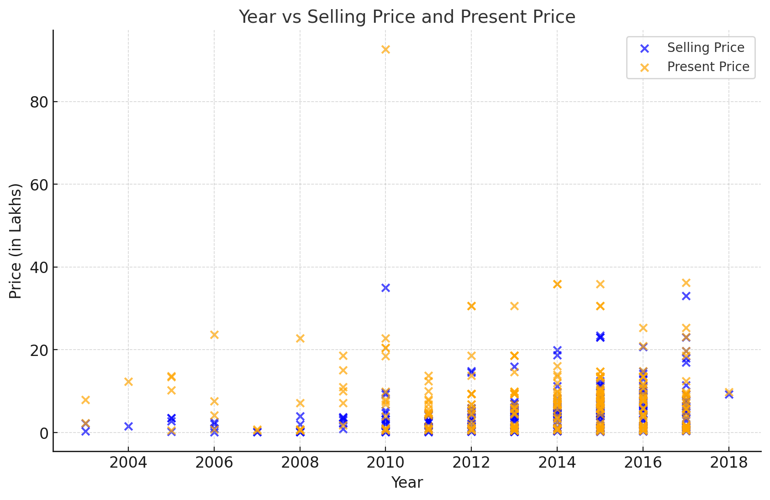
DATA OVERVIEW – EDA 2
The
1
Both average Present Price and Selling Price show an upward trend over the years, indicating an increase in vehicle pricing over time
2
The gap between Present Price and Selling Price widens significantly after 2014, reflecting higher depreciation rates for newer models
3
The scatterplot indicates increased variance in both Present Price and Selling Price for vehicles in recent years, suggesting a wider range of pricing options in the market
Price in Millions
Price in Millions
Notes:
First, analyzing the seasonality of prices over the years, we notice an overall upward trend for both average Present Price and Selling Price. This indicates a consistent rise in vehicle values over time, reflecting market growth
However, we observe a divergence after 2014, where the gap between Present Price and Selling Price widens significantly. This suggests that depreciation rates for newer models have increased, possibly influenced by market dynamics or evolving buyer preferences.
Finally, from the scatterplot on the right, it’s evident that the variance in Present Price and Selling Price has increased in recent years, highlighting a broader range of vehicle pricing options across different segments."

Slide 6
FEATURE ENGINEERING
Transforming raw data into meaningful features to enhance model performance and predictive accuracy.
FEATURE SELECTION
Calculated feature importance and focused on key columns like Kilometers driven and fuel type. Disregarded the Car Name column.
FEATURE TRANSFORMATION
We calculated the age of the car based on purchase year and derived Number of years (years since purchase).
ENCODING
One-hot encoding on features like fuel type, seller type and Transmission for model compatibility.

Slide 7
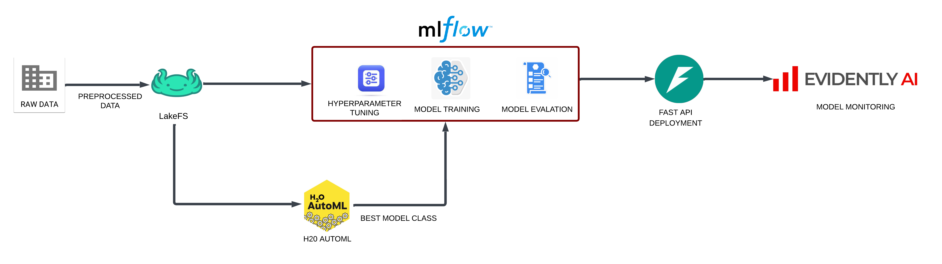
PIPELINE TO TRAIN THE MODEL
An end-to-end ML pipeline using H2O AutoML, lakeFS, and MLflow for model training, evaluation, and monitoring with Evidently AI.

Slide 8
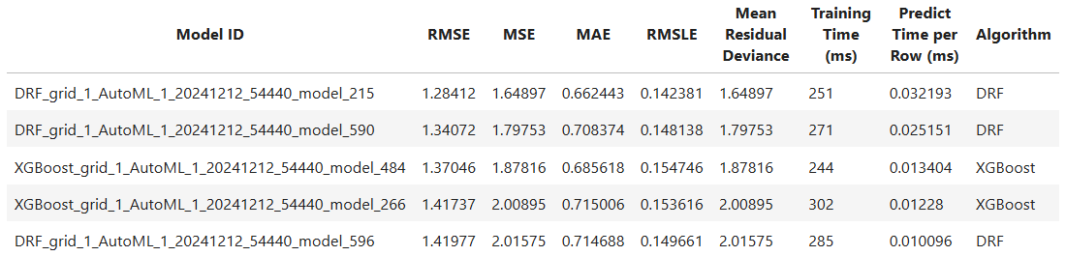

AUTO ML & CHOOSEN ALGORITHM
Top Algorithm: DRF (Distributed Random Forest)
Key Metrics:
RMSE: 1.284
MAE: 0.662
RMSLE: 0.142
Why DRF?
Outperformed other models like XGBoost in error metrics.
Balanced training (251 ms) and prediction speed (0.032 ms/row).
Notes:
Add H2o logo

Slide 9

MODEL TRAINING & MONITORING
Insert Video showing HTML files

Slide 10

TEST DATA SET – CHANGE
Insert Video showing HTML files

Slide 11

GITHUB LINK TO THE PROJECT
GitHub Link

Slide 12

Thank You !

